Slide 1
RSS News
Get News from RSS feeds by e-mails
Ayako D, Elodie B, Guillaume P

Slide 2
Agenda
What is RSS ?
RSS Recovery
Email Sending

Slide 3
I. What is RSS ?

Slide 4

What is RSS ?
Rich Site Summary
changing web content
syndicated content
XML format

Slide 5
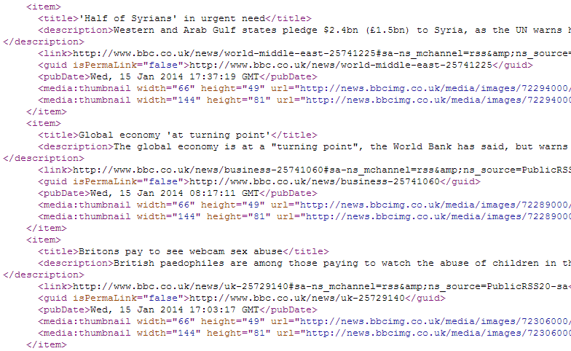
What does RSS look like ?

Slide 6
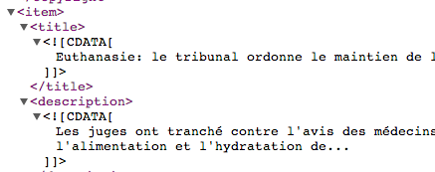
CDATA ?

Slide 7
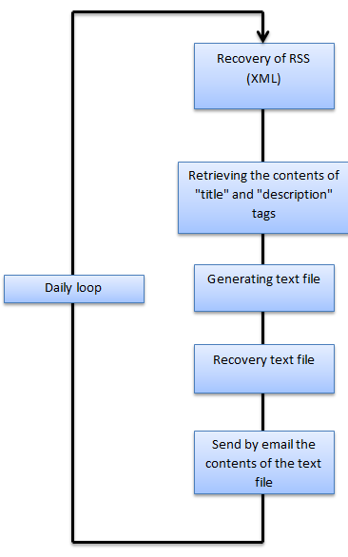
Workflow

Slide 8
II. RSS Recovery

Slide 9
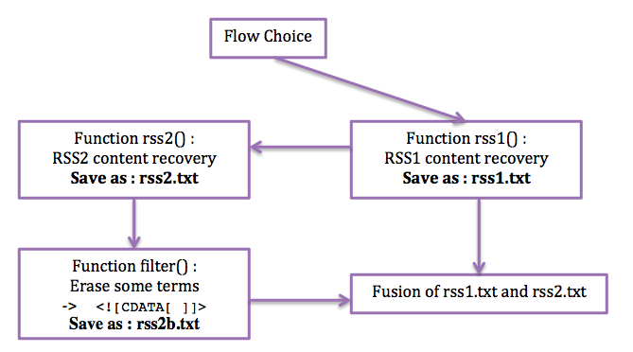
Flow Recovery
parser to ignore some characters could be interpreted by XML

Slide 10
Curl
make request to a server like http
-> GET method
-s | silent mode : don’t show progress meter

Slide 11
Grep
Filter
\{...\} | Repetition
\{Example\} | Repetition of Example (exactly)
\{Example,\} | Repetition of Example (minima)
\{Example 1 Example2\} | Repetition of Example1 to Example2
s | substrat : delete found terms
g | global : do it on each line

Slide 12
Sed
work line by line (flow mode)
-e | specify a simple command, between quotes (double or simple) to avoid some terms which can be interpreted by shell

Slide 13
III. Email Sending

Slide 14

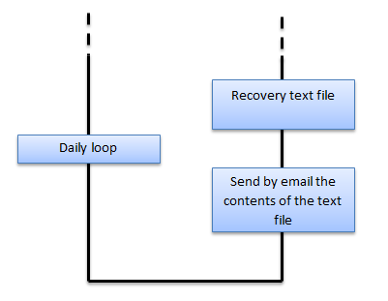
Automated email sending
Recovery text file : information RSS
Sending email with the contents of the text file via an SMTP server
Daily recurrence sending email : updating information

Slide 15

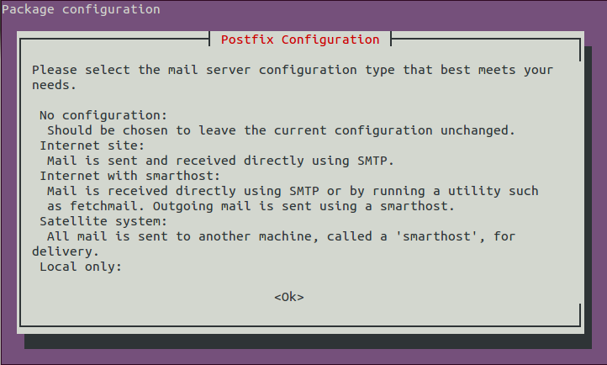
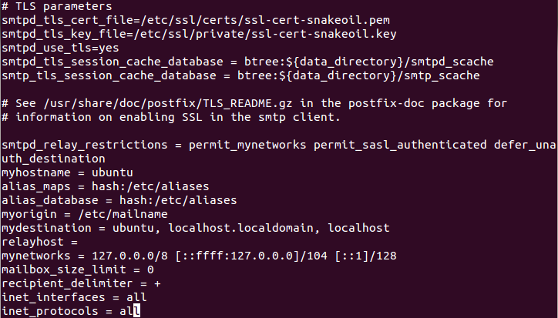
SMTP Server - text editor
Two envisaged solutions : SMTP server (Postfix) or text editor (Emacs)
SMTP server : "Simple Mail Transfer Protocol."
Communication protocol used to transfer electronic mail to mail servers.
SMTP server used : Postfix
- Installation and configuration :
apt-get install postfix
dpkg-reconfigure postfix
vi /etc/postfix/main.cf

Slide 16
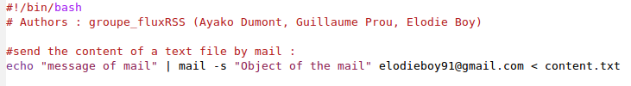
SMTP Server - text editor
script ssh :
Command line :

Slide 17


SMTP Server - text editor
Text editor : Emacs
Send an email with Emacs via Gmail
- “.emacs” file creation :
;;use the default agent with SMTP
(setq send-mail-function 'smtpmail-send-it)
;; send mails via smtp.gmail.com.
(setq smtpmail-smtp-server "smtp.gmail.com")
;; to specify the port used by 587 for TLS required by Gmail
(setq smtpmail-smtp-service 587)
;; use starttls, by specifying the server, port, private key and certificate, nil = null
(setq smtpmail-starttls-credentials '(("smtp.gmail.com" 587 nil nil)))
;; authentication password and login
(setq smtpmail-auth-credentials '(("smtp.gmail.com" 587 "adress@gmail.com" "password")))
Command line: emacs -nw
C-x m
C-c C-c

Slide 18

crontab

Slide 19
TO DO
Create a user interface
Configure mail server:
    send mail via openshift

